Slide 1
℞
Pharmacy e-commerce
An OOP-Based Console Application in C++
By:
Vishal Balasubramanian
Titus Samuel
Vignesh N

Slide 2
PROJECT OVERVIEW
A console-based Pharmacy Management System written in C++ that models a real-world online pharmacy with role-based access, medicine catalog, inventory tracking, cart system, prescription enforcement, and order pipeline.
Built with C++ using OOP concepts like inheritance, polymorphism, encapsulation, and abstraction
Role-Based Access
Medicine and Order Lifecycle
Cart & Exception Handling
3 distinct user roles: Admin, Doctor, and Customer— each with dedicated menus and permissions enforced at runtime.
Password verification functionality
Maintains a unique user id using a static counter
All Medicines are categorized as OTC or Prescription
Orders track medicine ID, quantity, and delivery location in one object
Three-stage status pipeline — Processing → Shipped → Delivered
Customers can add and remove medicines from a personal cart
Duplicate medicines are automatically prevented from being added to the cart
Meaningful error messages are shown for missing medicines, and out-of-stock items
Key Features of Project

Slide 3
USE OF OOP IN PROJECT
Encapsulation:
Abstraction
User
User
Focuses on wrapping data members and member functions into a single unit with restricted access.
User data like passwords and IDs are kept private and accessed only through dedicated methods
Medicine and order details are bundled within their respective classes
Concept of hiding implementation details and exposing only the necessary features of an object.
The base User class defines a common interface without revealing role-specific details
Customers interact with a simple cart system without knowing how it manages medicines internally with complex calls and implementation details hidden
Inheritance
Polymorphism
User
User
Allowing a class to derive properties and behavior from an existing class.
Admin, Doctor, and Customer all inherit common properties like username and password from User
OTC and Prescription medicines share a base Medicine class, avoiding repeated code
A core concept where a single function or entity can take up multiple forms based on the situation at runtime
Each user role displays its own information differently despite sharing the same method name
OTC and Prescription medicines print their own type label through the same display call

Slide 4
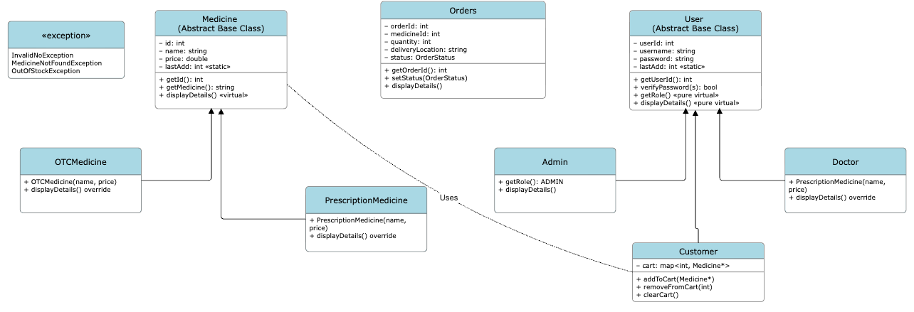
UML CLASS DIAGRAM

Slide 5
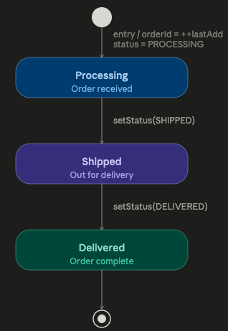
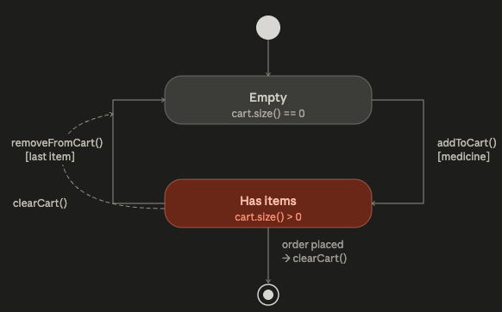
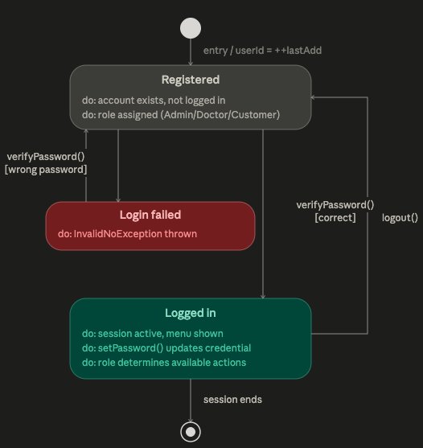
STATE MACHINE DIAGRAMS
Cart Object
Order Object
User Object

Slide 6
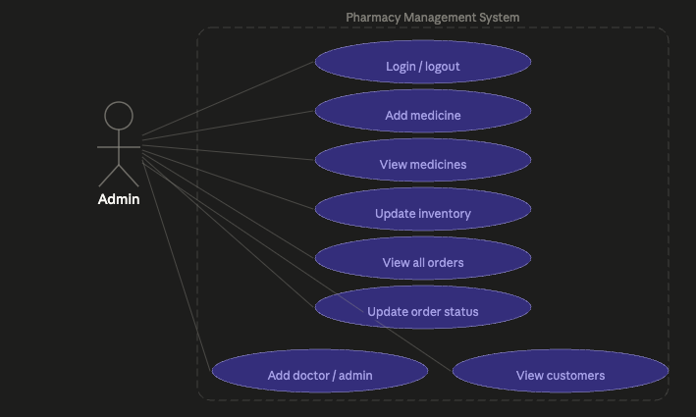
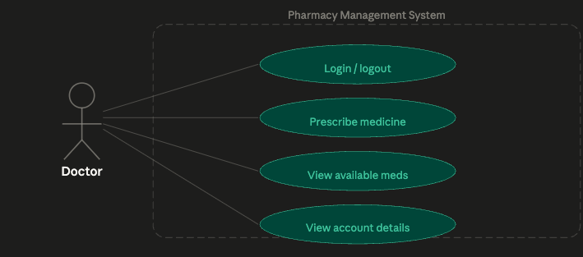
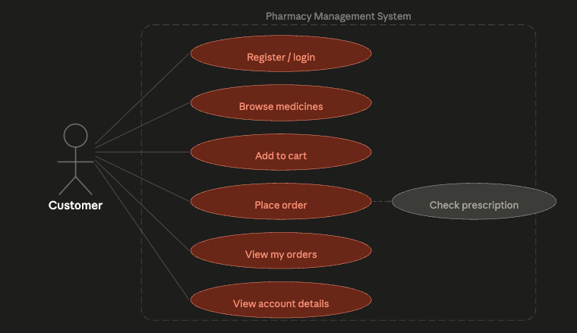
USE CASE DIAGRAMS

Slide 7
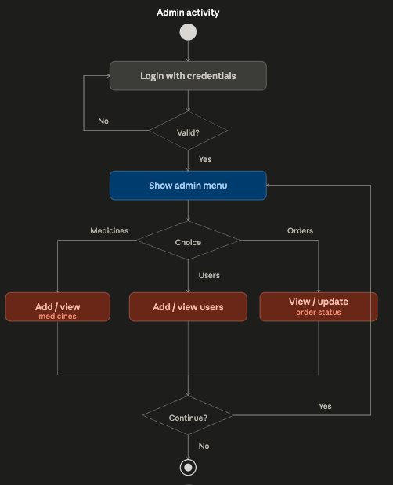
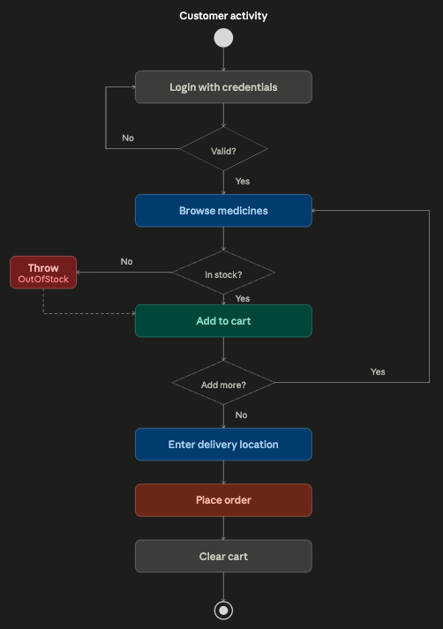
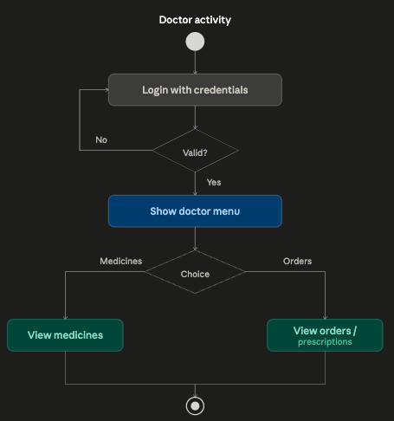
ACTIVITY DIAGRAMS

Slide 8
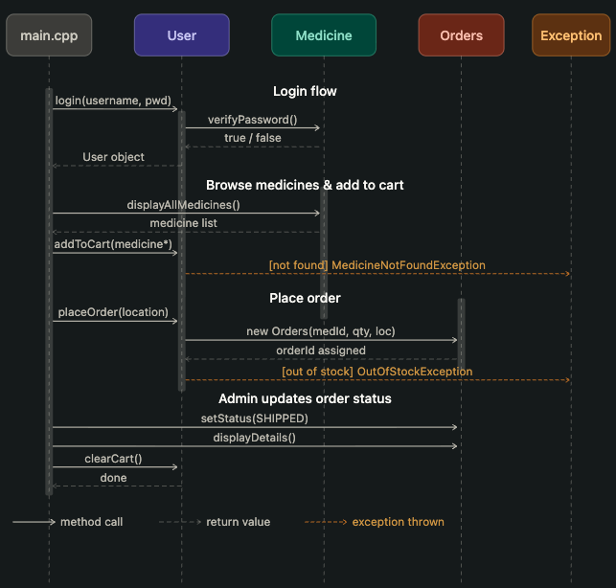
SEQUENCE DIAGRAM

Slide 9
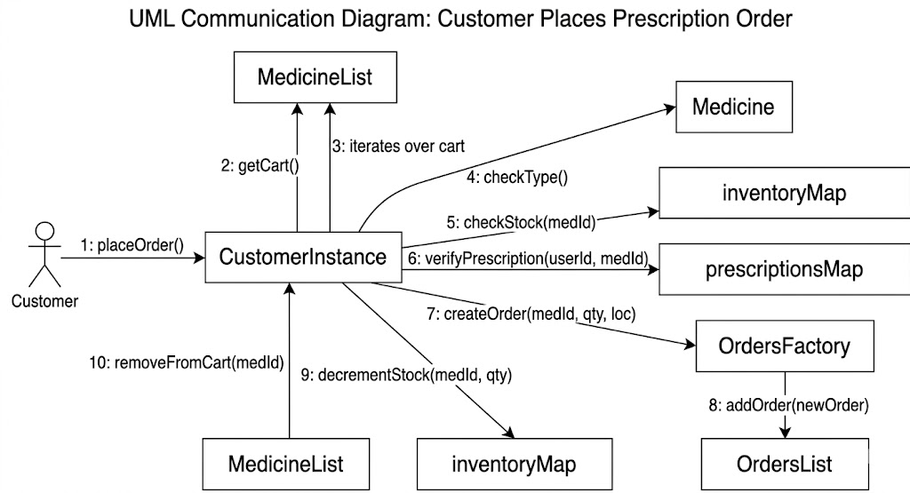
COMMUNICATION DIAGRAM

Slide 10
STL AND DATA STRUCTURES USED
Variable
Type
Purpose
Static ID Counters
users
vector<User*>
All registered users
Medicine::lastAdd, Orders::lastAdd, User::lastAdd — auto-increment shared IDs across all instances
medicines
unordered_map<int,
Medicine*>
Catalog keyed by medicine ID
inventory
unordered_map<int,int>
Stock count per medicine
O(1) Lookup
unordered_map used for medicines, inventory, orders, and prescriptions — fast access by integer key
orders
unordered_map<int,
vector<Orders>>
Orders grouped by customer ID
prescriptions
unordered_map<int,
vector<int>>
Prescribed medicine IDs per customer
Memory Note
cart
map<int, Medicine*>
Per-customer cart; prevents duplicates
User* and Medicine* are heap-allocated via new but never deleted — a known memory leak in the current implementation

Slide 11
EXCEPTION HANDLING
All three exception classes inherit from std::exception and override what() with descriptive C-string messages.
InvalidNoException
Caught in: processAdmin
Thrown when: Negative value entered for price or quantity
MedicineNotFoundException
Caught in: processCustomer
Thrown when: Medicine ID doesn't exist in the catalog
OutOfStockException
Caught in: processCustomer
Thrown when: Medicine's inventory quantity is zero or less
Caught selectively at role-handler boundaries to prevent crashes and provide user-friendly error messages.

Slide 12
PROJECT FILE STRUCTURE
errors.h
Custom exception classes for domain-specific error handling
medicine.h / .cpp
Medicine class hierarchy (OTC & Prescription types)
orders.h / .cpp
Order class with status lifecycle tracking
users.h / .cpp
User class hierarchy with role-based logic (Admin, Doctor, Customer)
main.cpp
Global data, helper functions, role menus, and entry point

Slide 13
CONCLUSION
Pharmacy e-commerce — OOP Project Summary
1
Full OOP Architecture —
Inheritance, pure virtual methods, polymorphism, and dynamic_cast throughout
2
STL-Powered Data Layer —
vector, unordered_map, and map chosen for correct semantics and O(1) performance
3
Role-Based Security —
Each user type accesses only its own menu; prescriptions enforce one-time Rx use
4

